Slide 1
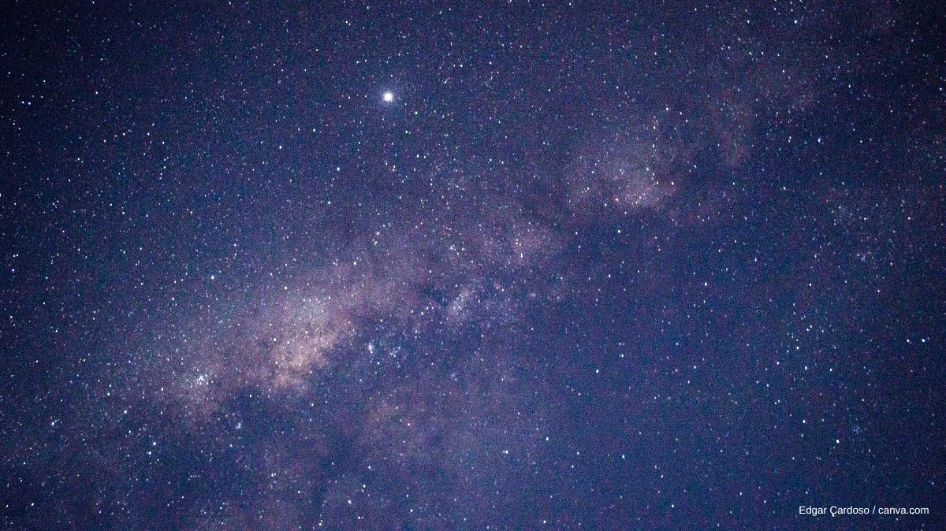
M-σ Relation
By Alexander Risy, Christian Bauer, Jürgen Kapeller, Arthur Völkerer

Slide 2
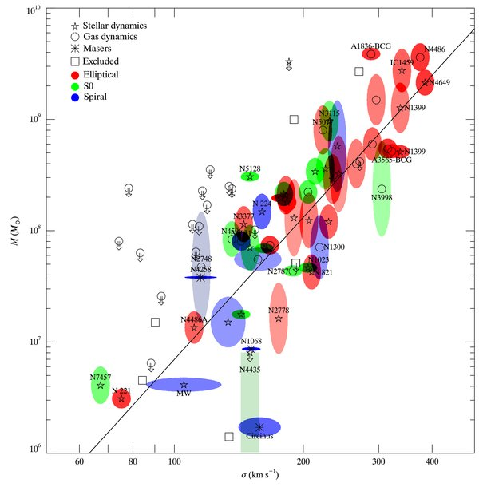

The basics
Mass of black hole and velocity dispersion
The larger the BH, the greater the velocity dispersion of the stars (for the dynamics in the galaxies centre)
Feedback mechanism between black hole and bulge mass
Origin of scatter
Galactic Feedback
$\log\left(M_{BH}\right)=α\log\left(σ\right)+β$
…

Slide 3
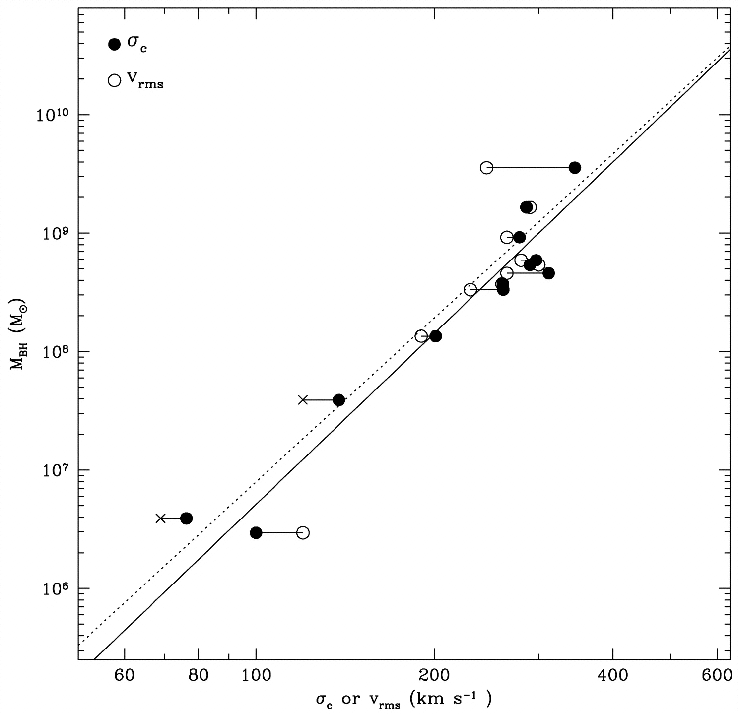
Original Data
12 galaxies with secure BH mass estimates are sample A
sample A BH masses determined by gas/stellar kinematics, in MW case with proper motion, in NGC 4258 case with kinematics of water maser clumps
these methods are dependent on distance, distances obtained with surface brightness fluctuation, redshift, proper motion
a sample B with less secure BH mass estimates was also used, the M-sigma relation for this sample had a different fit than sample A

Slide 4
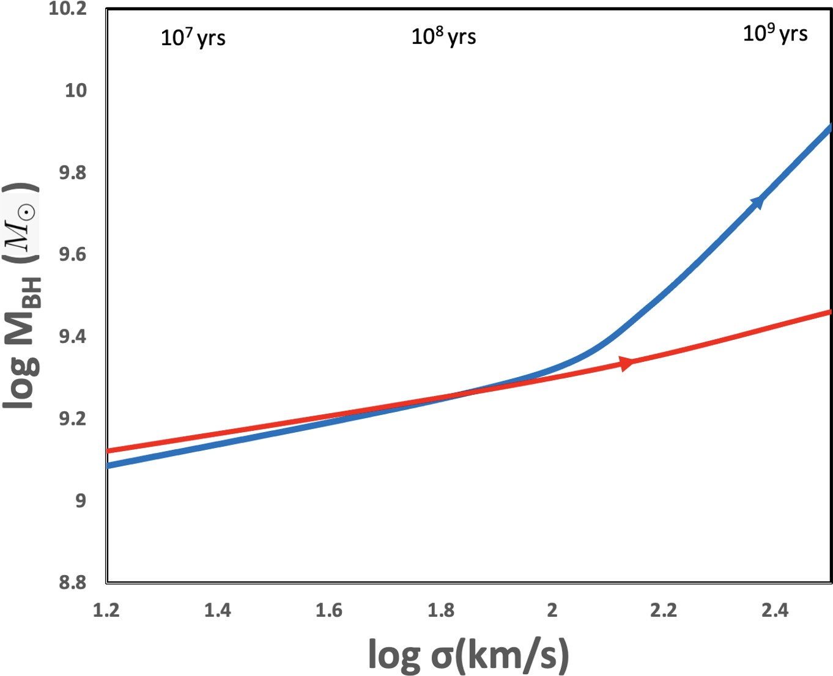

Recent studies
Difference between active nucleus ( AGN) with and without jets:
Theoretical basis
Probably no connection with dark matter
BH distributes metals
Development of BH and Galaxies
Romulus25 simulation
$3e9 M_{Sun}< M_{BH}<3e11 M_{Sun}$
Blue line: Radio quiet quasars Red line: Radio loud quasars

Slide 5
Literatur
Data set: https://iopscience.iop.org/article/10.1088/0004-637X/698/1/198
Original paper: https://ui.adsabs.harvard.edu/abs/2000ApJ...539L...9F/abstract
Review 1: https://ui.adsabs.harvard.edu/abs/2019GReGr..51...65Z/abstract
Review 2: https://ui.adsabs.harvard.edu/abs/2020FrP.....8...61M/abstract
New 1: https://ui.adsabs.harvard.edu/abs/2024ApJ...967..100S/abstract
New 2: https://ui.adsabs.harvard.edu/abs/2022Galax..10...73G/abstract
New 3: https://ui.adsabs.harvard.edu/abs/2023OJAp....6E..27G/abstract

